Slide 1
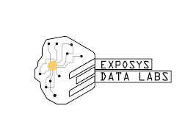
Customer segmentation
By: 1. Amisha Gokhale
2. Jayesh Bhalchim

Slide 2
Introduction
An important marketing strategy that is widely used by businesses is customer segmentation. As previously stated, the point of customer segmentation is to split the user-base into smaller groups that can be targeted with specialized content and offers.
The produced customer groups are drawn from user behavior data which gives the business a deeper understanding of the types of users that exists in the system

Slide 3
Benefits
The benefit of customer segmentation is twofold.
Firstly, a better knowledge about the types of users in a system can lead to better business and marketing strategies.
Secondly, a user is likely to use an application more often if he/she always receives relevant content.
Another essential point is that if a customer is pleased, he/she is more likely to recommend the application to other people which helps in the expansion of a company

Slide 4
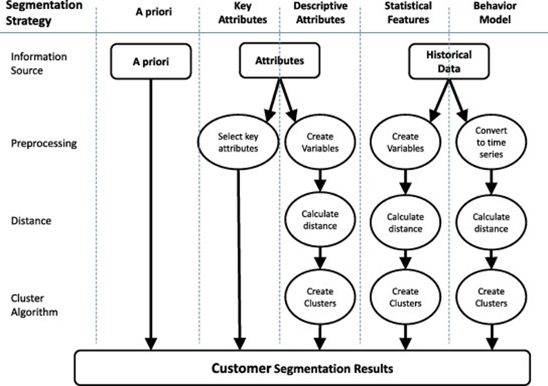

Slide 5
PROPOSED METHODOLOGY:
The whole process is to be carried out in two phases
Phase 1: Customer Segmentation
Phase 2: Extracting associative buying pattern of segmented customer

Slide 6
Phase 1:
Customer Segmentation
Step 1: Collecting Customer Data (Transactional data): This step involves the collection of transactional customer data comprises of their static (Eg: Age, Gender etc.) and dynamic data (Eg: Purchase frequency etc.) [1] from shopping vendors.

Slide 7
Phase 2:
Pre-processing of Data:
Pre-processing of the data is one of the important steps for the accuracy of predictive model. In this step, the collected data will be cleaned, and relevant features will be extracted. Feature selection is a data reduction technique which is responsible for extracting relevant features required for input vector of predictive model. This acts as pre-processing steps for creating subset of original features by excluding those features which are redundant.
Proposes correlation technique for extracting relevant features. Correlation measures the relationship between two features. Basically, it simply filters those features which are not redundant to form subset of original features. To measure the association between features correlation coefficient is calculated between two features and based on its value.

Slide 8
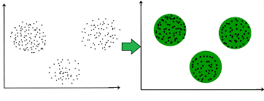
Clustering
Clustering is the task of dividing the population or data points into a number of groups such that data points in the same groups are more similar to other data points in the same group and dissimilar to the data points in other groups. It is basically a collection of objects on the basis of similarity and dissimilarity between them.

Slide 9
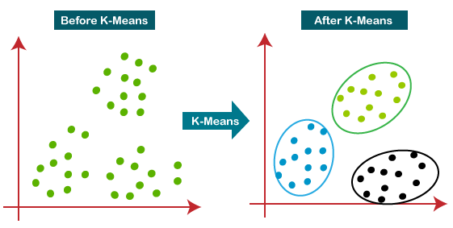
K-means clustering
The k-means clustering algorithm divides the n records into k segments of records called clusters where k ≤ n, so as to minimize the distances between records within a particular cluster.

Slide 10
Cont.…
We specify the number of clusters that we need to create.
The algorithm selects k objects at random from the dataset. This object is the initial cluster or mean.
The closest centroid obtains the assignment of a new observation. We base this assignment on the Euclidean Distance between object and the centroid.
k clusters in the data points update the centroid through calculation of the new mean values present in all the data points of the cluster. The kth cluster’s centroid has a length of p that contains means of all variables for observations in the k-th cluster. We denote the number of variables with p.
Iterative minimization of the total within the sum of squares. Then through the iterative minimization of the total sum of the square, the assignment stop wavering when we achieve maximum iteration. The default value is 10 that the R software uses for the maximum iterations.

Slide 11

Determining Optimal cluster
While working with clusters, you need to specify the number of clusters to use. You would like to utilize the optimal number of clusters. To help you in determining the optimal clusters, there are three popular methods –
Elbow method
Silhouette method
Gap statistic

Slide 12
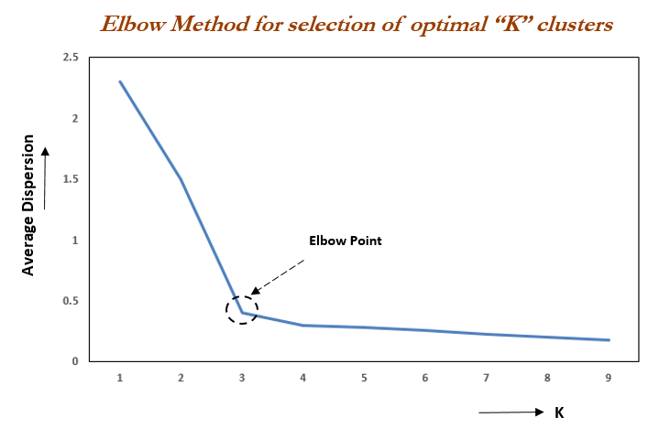
Elbow Method
The main goal behind cluster partitioning methods like k-means is to define the clusters such that the intra-cluster variation stays minimum.
minimize(sum W(Ck)), k=1…k
Where Ck represents the kth cluster and W(Ck) denotes the intra-cluster variation. With the measurement of the total intra-cluster variation, one can evaluate the compactness of the clustering boundary.

Slide 13
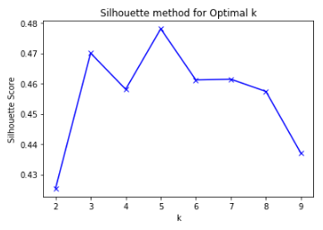
Average Silhouette Method
With the help of the average silhouette method, we can measure the quality of our clustering operation. With this, we can determine how well within the cluster is the data object. If we obtain a high average silhouette width, it means that we have good clustering. The average silhouette method calculates the mean of silhouette observations for different k values. With the optimal number of k clusters, one can maximize the average silhouette over significant values for k

Slide 14
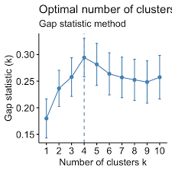
Gap Statistic Method
Abstract The Gap statistic is a standard method for determining the number of clusters in a set of data. The Gap statistic standardizes the graph of log(Wk.), where Wk. is the within-cluster dispersion, by comparing it to its expectation under an appropriate null reference distribution of the data.

Slide 15
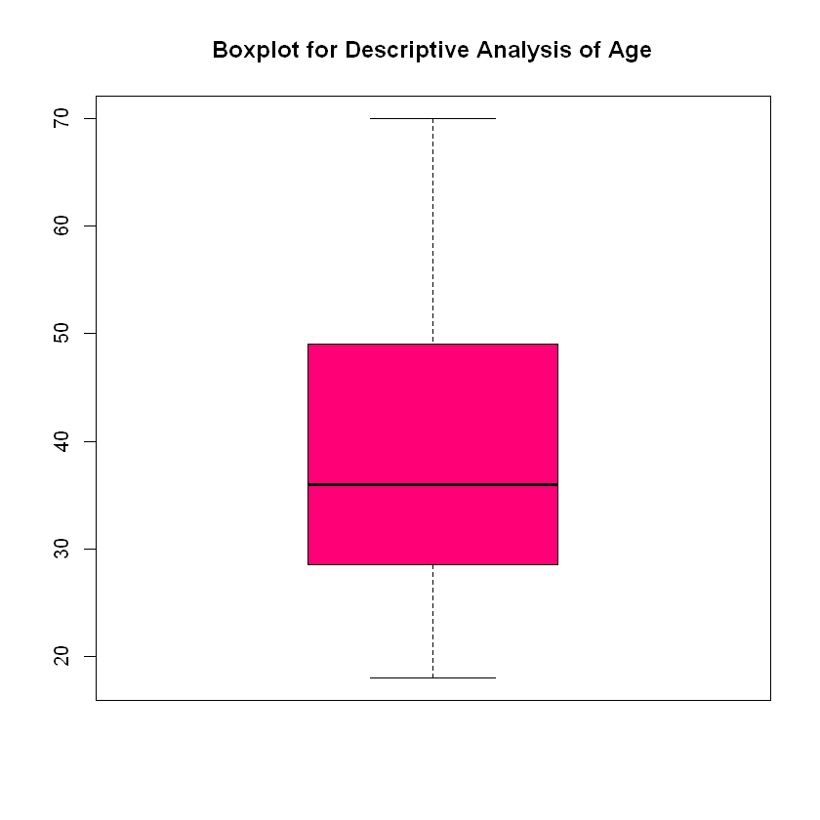
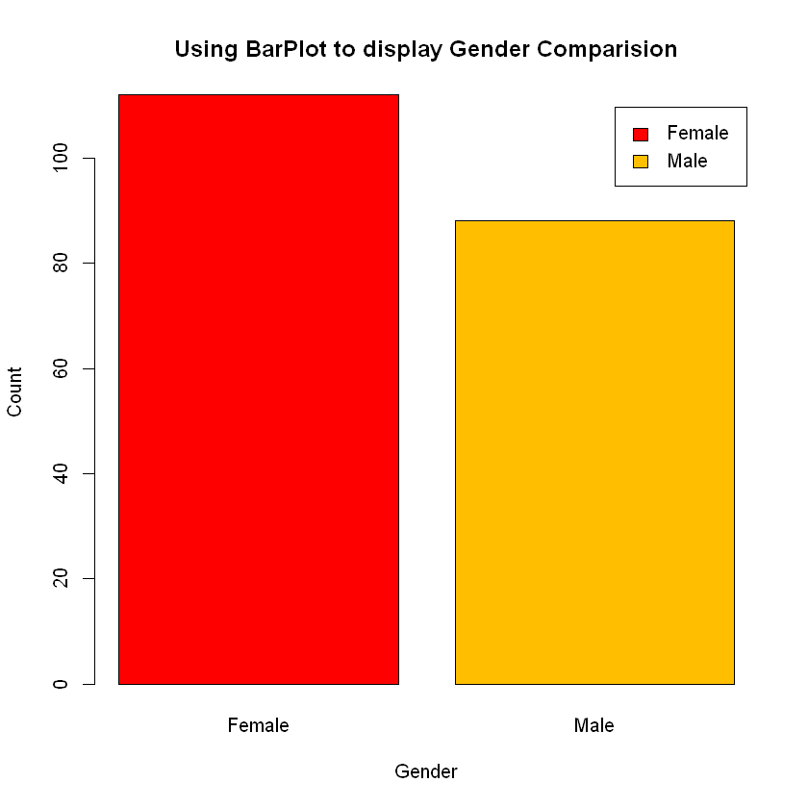
Outputs

Slide 16
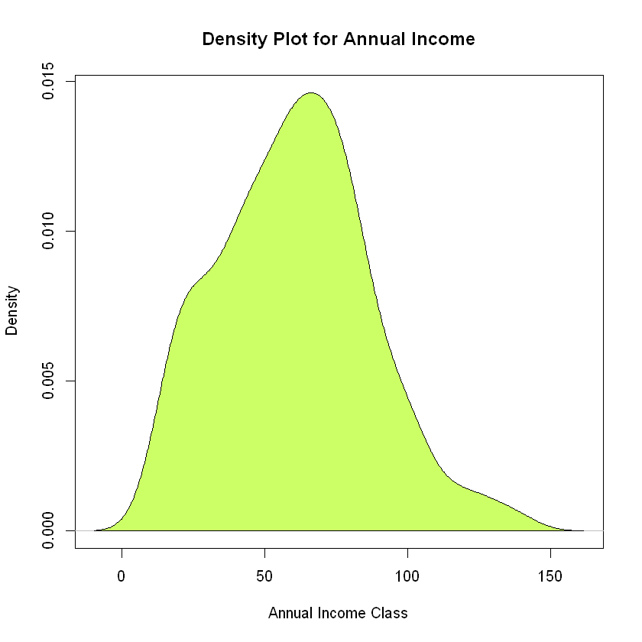
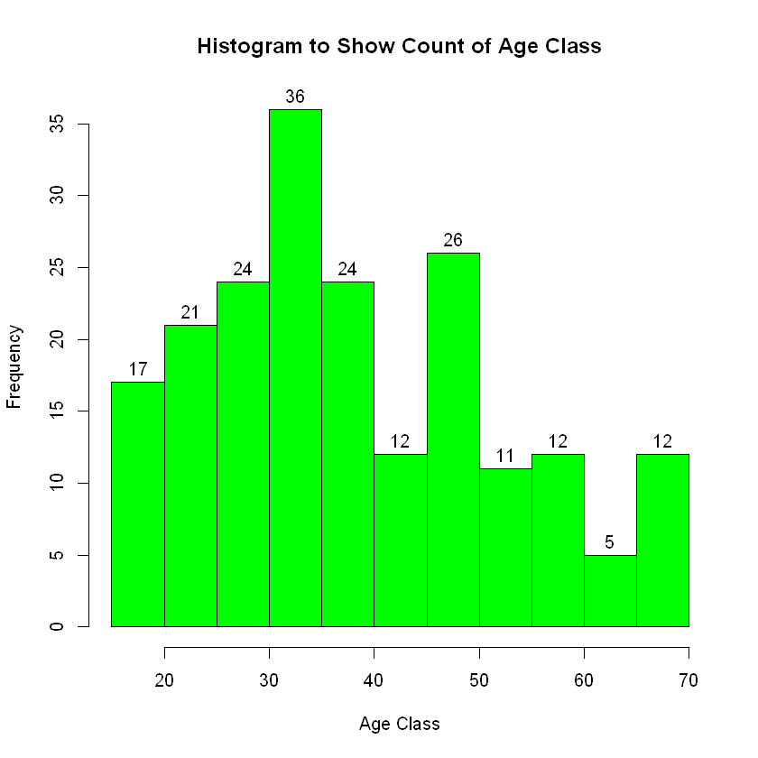

Slide 17
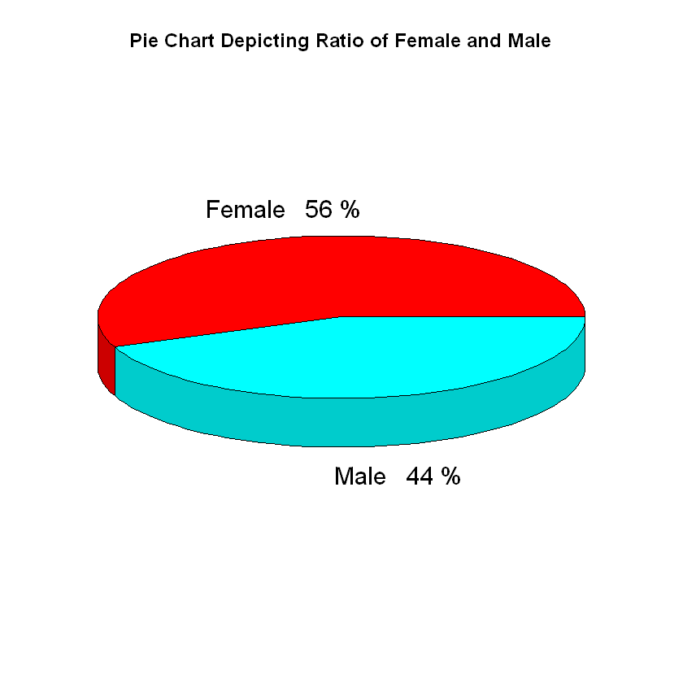
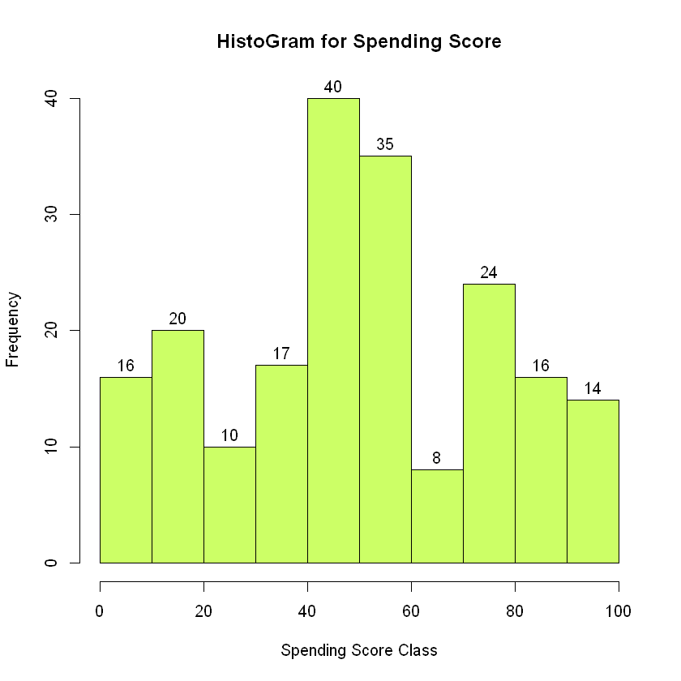

Slide 18
Summary
In this data science project, we went through the customer segmentation model. We developed this using a class of machine learning known as unsupervised learning. Specifically, we made use of a clustering algorithm called K-means clustering. We analysed and visualized the data and then proceeded to implement our algorithm.

Slide 19

Conclusion
In competitive market of e-commerce, the problem of identifying potential customer is gaining more and more attention. To address this problem timely, this paper proposes a study on integrated novel approach based on clustering using K-means and associative mining using Apriori technique. After identification of targeted customers and their associative buying pattern, the business managers take the strategic profitable decisions accordingly. This integrated model could be directly brought into implementation for providing better profitable margins from sales.

Slide 20
REFERENCES
1. XIANG-BIN YAN, YI-JUN LI, Customer Segmentation based on Neural Network with Clustering Technique, 5th WSEAS Int. Conf. on Artificial Intelligence, Knowledge Engineering and Data Bases, Madrid, Spain, February 15-17, 2006 (pp265-268).
2. Ling Luo, Bin Li et. al. “Tracking the Evolution of Customer Purchase Behaviour Segmentation via a Fragmentation-Coagulation Process”, Twenty-Sixth International Joint Conference on Artificial Intelligence (IJCAI-17).
3. Mark K.Y.Mak,George T.S.Ho,S.L.Ting,“A Financial Data Mining Model for extracting Customer Behaviour”, INTECH open access publisher, 23 July 2011.
4. Juni Nurma San, Lukito Nugroho, Ridi Ferdiana, P.InsapSantosa, “A Review on Customer Segmentation Technique on E-Commerce”, Advance Science Letters, Vol.4, 400-407,2011.
5. Kishana R. Kashwan, Member, IACSIT, C.M.Velu, “Customer Segmentation using clustering and Data Mining Techniques”, International Journal of Computer Theory and Engineering, Vol.5, No.6, December 2013.
6. LuoYe, CaiQiuru, XiHaixu,LiuYijun and Zhu Ghuangping , “Customer Segmentation for Telecom with the k-means Clustering Method”, Information Technology Journal 12(3):409-413,2013 .

